Slide 1
Image Representation
Course Code: CSC 3224
Course Title: Computer Graphics
Dept. of Computer Science
Faculty of Science and Technology
Rahul Biswas​
Email: rbiswas@aiub.edu
Lecturer, CS Department
Room No: DNO127D​

Slide 2
Outline
Pixel
Graphics Image
Color Model (RGB, CMY)
Direct Coding
Lookup Table
Display Monitor
Printing
Image Files
Books
References

Slide 3
Computer Graphics
Computer Graphics is the use of computers to display and manipulate graphical or pictural form, either on a usual display unit or via a printer.

Slide 4
Usages
Computer Aided Design
Presentation Graphics
Computer Art
Entertainment
Education & Training
Visualization
Image Processing
GUI

Slide 5
Keywords​
Pixels​
Resolution​
PPI(Pixel Per Inches)​
Aspect Ratio​
Frame Buffer​

Slide 6
Pixel
A pixel is one of the many tiny dots that make up the representation of a picture in a computer's memory.
Pixels in an image can be reproduced at any size without the appearance of visible dots or squares
The intensity of each pixel is variable; in color systems, each pixel has typically three or four dimensions of variability such as red, green and blue, or cyan, magenta, yellow and black

Slide 7
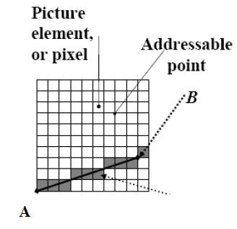
Pixel

Slide 8
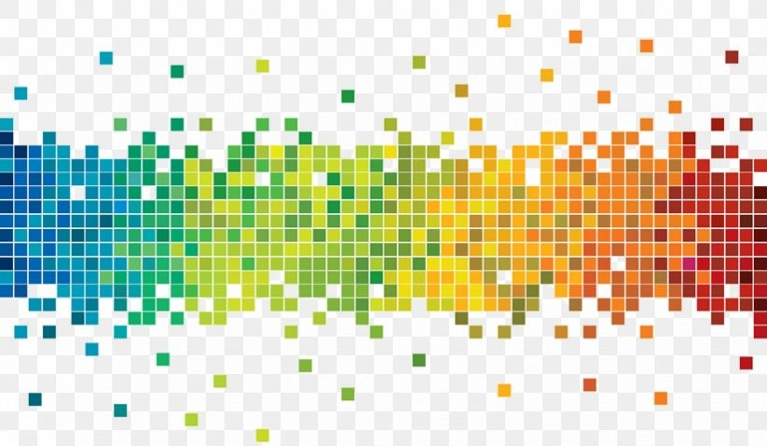
Pixel
https://www.linkedin.com/pulse/what-pixel-graphics-design-graphics-designer

Slide 9
Computer Graphics Image
Computer graphics can be created as either raster or vector images
Raster Image
Vector Image

Slide 10
Raster Image
Raster graphics are bitmaps.
A bitmap is a grid of individual pixels that collectively compose an image.
Raster graphics render images as a collection of countless tiny squares.
Each square, or pixel, is coded in a specific shade. Individually, these pixels are worthless
Together, they’re worth a thousand words

Slide 11
Raster Image
Using of Raster Image
Raster graphics are best used for non-line art images; specifically digitized photographs, scanned artwork or detailed graphics
Non-line art images are best represented in raster form because these typically include subtle chromatic gradations, undefined lines and shapes, and complex composition

Slide 12
Drawbacks of Raster Image
Resolution in raster graphics is measured in dpi, or dots per inch. The higher the dpi, the better the resolution
Raster files are significantly larger than comparable vector files, high resolution raster files are significantly larger than low resolution raster file
Overall, as compared to vector graphics, raster graphics are less economical, slower to display and print, less versatile and more unwieldy to work with

Slide 13
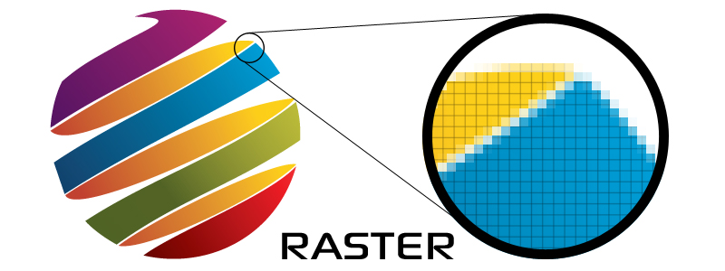
Example of Raster Image
Common raster formats include TIFF, JPEG, GIF, PCX and BMP files

Slide 14
Vector Image
Unlike pixel-based raster images, vector graphics are based on mathematical formulas that define geometric primitives such as polygons, lines, curves, circles and rectangles

Slide 15
Use of Vector Image
Because vector graphics are composed of true geometric primitives, they are best used to represent more structured images, like line art graphics with flat, uniform colors.
Most created images meet these specifications, including logos, letterhead, and fonts.

Slide 16
Advantages of Vector Image
Vector-based graphics are more malleable than raster images
They are much more versatile, flexible and easy to use
The most obvious advantage of vector images over raster graphics is that vector images are quickly and perfectly scalable
There is no upper or lower limit for sizing vector images

Slide 17
Advantages of Vector Image
Unlike raster graphics, vector images are not resolution-dependent
Vector images have no fixed intrinsic resolution, rather they display at the resolution capability of whatever output device (monitor, printer) is rendering them
Because vector graphics need not memorize the contents of millions of tiny pixels, these files tend to be considerably smaller than their raster counterparts.

Slide 18
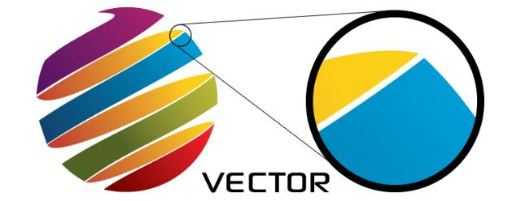
Vector Images
Overall, vector graphics are more efficient and versatile.
Common vector formats include AI, EPS, CGM, WMF and PICT (Mac).

Slide 19
Color Model
A color model is a system for creating a full range of colors from a small set of primary colors.
There are two types of colour models: additive and subtractive.

Slide 20
Additive and Subtractive Model
Additive color models use light to display color
While subtractive color models use printing inks.
Colors perceived in additive models are the result of transmitted light.
Colors perceived in subtractive models are the result of reflected light.

Slide 21
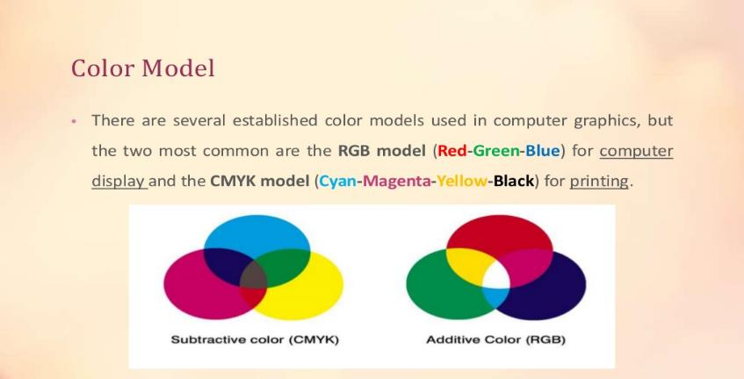
RGB and CMYK

Slide 22
RGB
RGB uses additive color mixing, because it describes what kind of light needs to be emitted to produce a given color.
Light is added together to create form from out of the darkness.
RGB stores individual values for red, green and blue.
(r,g,b)=>(0,0,0) black, (1,1,1) white [ranges 0 to 1]

Slide 23
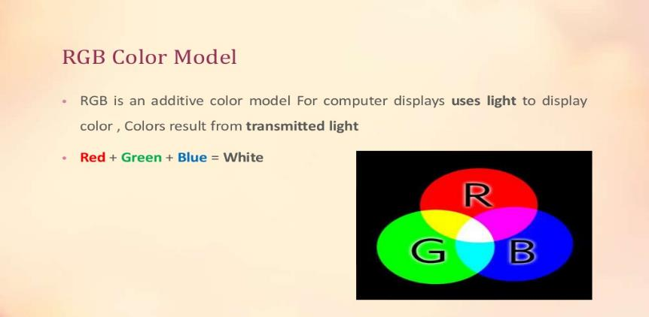
RGB

Slide 24
RGB Value
A color's RGB value indicates its red, green, and blue intensity.
Each intensity value is on a scale of 0 to 255

Slide 25
RGB Color Palette
3-bit RGB
Systems with a 3-bit RGB palette use 1 bit for each of the red, green and blue color components. That is, each component is either "on" or "off" with no intermediate states. This results in an 8-color ((2¹)³ = 2³ = 8) palette
6-bit RGB
Systems with a 6-bit RGB palette use 2 bits for each of the red, green, and blue color components. This results in a (2²)³ = 4³ = 64-color palette

Slide 26
Color Palette
In computer graphics, a color palette is a finite set of colors. Palettes can be optimized to improve image accuracy in the presence of software or hardware constraints.

Slide 27
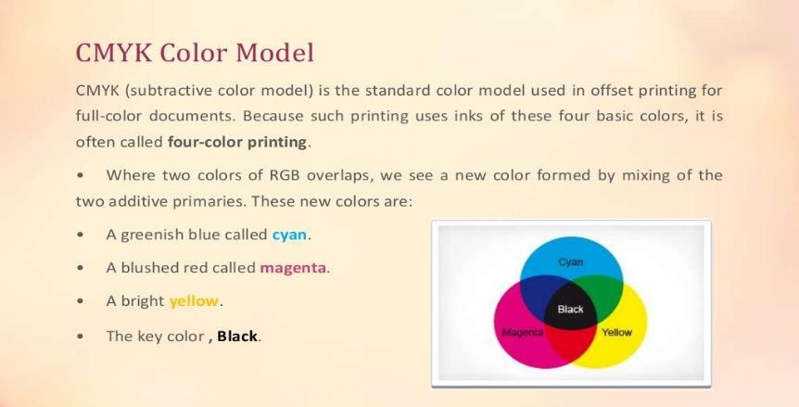
CMYK

Slide 28
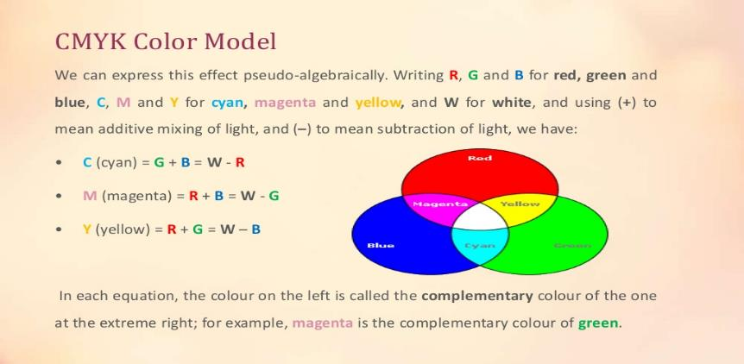
CMYK

Slide 29
CMY
CMY uses subtractive color mixing used in the printing process, because it describes what kind of inks need to be applied so the light reflected from the substrate and through the inks produces a given color.
One starts with a white substrate (canvas, page, etc.), and uses ink to subtract color from white to create an image.
CMYk stores ink values for cyan, magenta, yellow, Key(Black).
cmyk(c%, m%, y%)=>(0%,0%,0%) white. [ranges from 0 to 100%]

Slide 30
RGB to CMY
C = 1 –( color.R / 255.0);
M = 1 – (color.G / 255.0);
Y = 1 – (color.B / 255.0);

Slide 31
CMY to RGB
R = (1 - C) * 255.0,
G = (1 - M) * 255.0,
B = (1 - Y) * 255.0

Slide 32
RGB -> CMY -> RGB
More info
http://colormine.org/convert/rgb-to-cmy
Sample Code:
https://github.com/THEjoezack/ColorMine/blob/master/ColorMine/ColorSpaces/Conversions/CmyConverter.cs

Slide 33
Direct Coding
Basically images are the collections of several pixels with colors. In computer graphics, direct coding is an algorithm that provides some amount of storage space for each pixel so that the pixel is coded with a color.

Slide 34
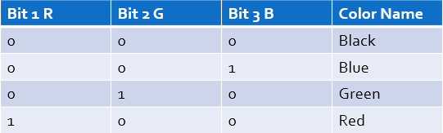
Direct Coding
Storage space for each pixel to code the color
Use 3 bits per pixel (1 for R, 1 for G and 1 for B) [Industry standard]
256 different intensity level for each color

Slide 35
Direct Coding
More info of direct coding:
https://www.chegg.com/homework-help/definitions/direct-coding-3

Slide 36
Lookup Table
In computer graphics, lookup tables are used to store the starting addresses of each line and the values corresponding to the placement of pixels within a byte.

Slide 37
Steps to plot a point using lookup table
1. Locate the starting address corresponding to the line on which the point is to appear.
2. Locate the address of the byte in which the point will be represented.

Slide 38
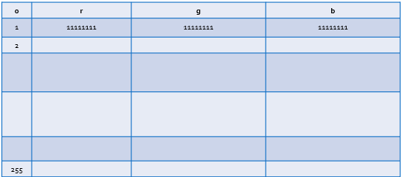
Lookup Table
Pixel values do not code colors directly
Refer to a table of color values
A table with 256 colors with RGB values

Slide 39
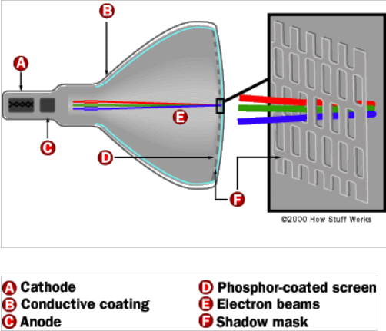
Display Monitor (CRT)

Slide 40
Printing
Halftone
Go through chapter 2 (schaum’s outline) for details.

Slide 41
Halftone
Halftone is the technique that simulates continuous tone imagery through the use of dots.
Dots can be varied either
in size
in shape or
in spacing
Halftone generates a gradient like effect.

Slide 42
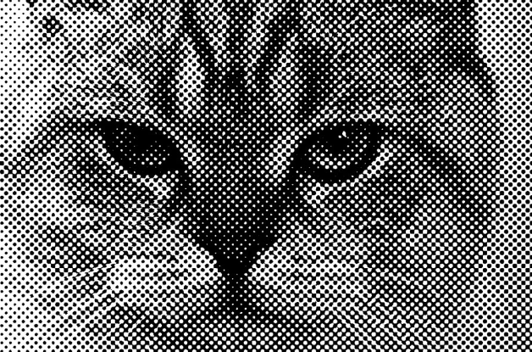
Halftone

Slide 43
Halftone Image
A halftone, or halftone image, is an image comprised of discrete dots rather than continuous tones. When viewed from a distance, the dots blur together, creating the illusion of continuous lines and shapes.
By halftoning an image (converting it from a bitmap to
a halftone), it can be printed using less resources

Slide 44
How Halftone work
Halftone process, in printing, a technique of breaking up an image into a series of dots so as to reproduce the full tone range of a photograph or tone art work.

Slide 45
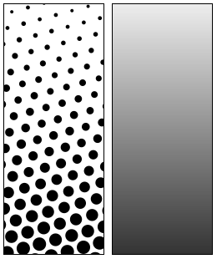
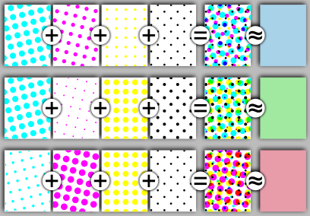
Example

Slide 46
Books
Foley, van Dam, Feiner, Hughes, Computer Graphics: principles and practice, Addison Wesley, Second Edition.
Schaum's Outline of Theory & Problems of Computer Graphics.
Peter Shirley Steve Marschner , “Fundamental of computer graphics”, Third Edition.

Slide 47
References
http://colormine.org/convert/rgb-to-cmy
www.howstuffworks.com
www.wikipedia.com
http://www.picturetopeople.org/image_effects/photo-halftone/examples/photo-to-halftone-convertion-2.gif
http://mocoloco.com/fresh2/upload/2011/12/halftone_calendar_by_casey_klebba/halftone_calendar_casey_klebba_3b-thumb-468x468-35319.jpg
https://www.chegg.com
https://www.slideshare.net/mustafasalam167/color-model-29181025
https://www.printcnx.com/resources-and-support/addiational-resources/raster-images-vs-vector-graphics/
https://slideplayer.com/slide/5143930/

